Slide 1
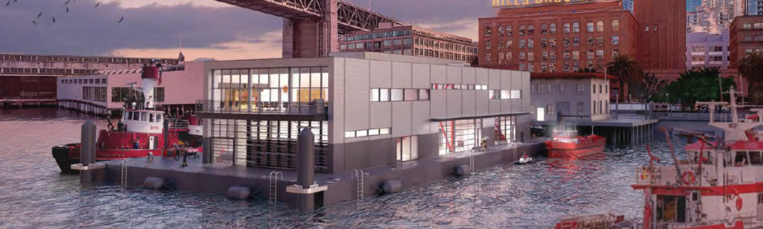
ESG in San Francisco
Brian Strong
Office of Resilience and Capital Planning
City and County of San Francisco
November 7, 2019

Slide 2
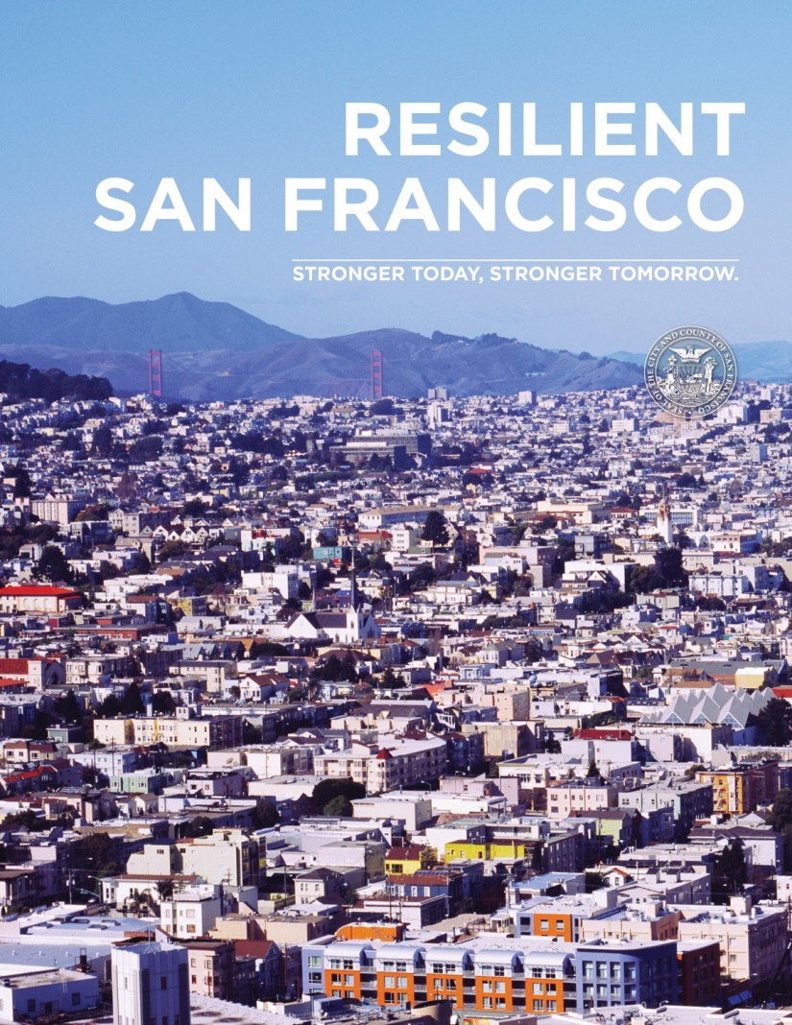
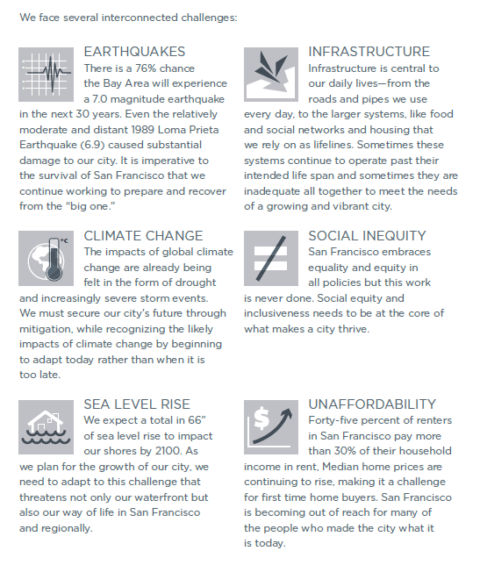
EARTHQUAKES
INFRASTRUCTURE
CLIMATE CHANGE
SOCIAL INEQUITY
SEA LEVEL RISE
UNAFFORDABILITY

Slide 3
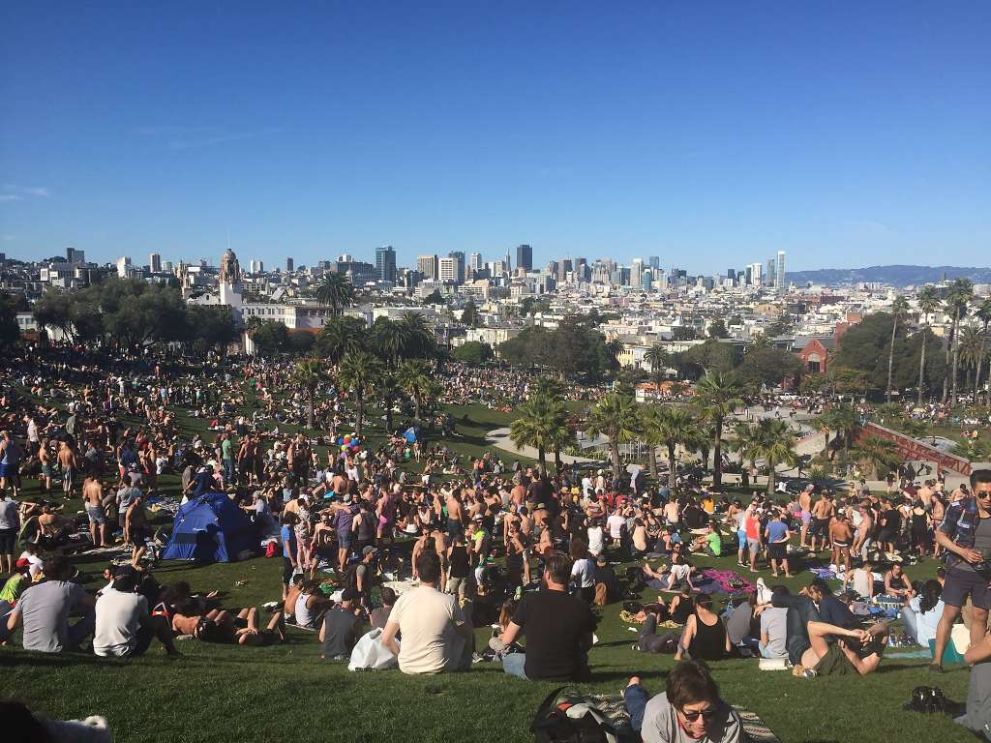
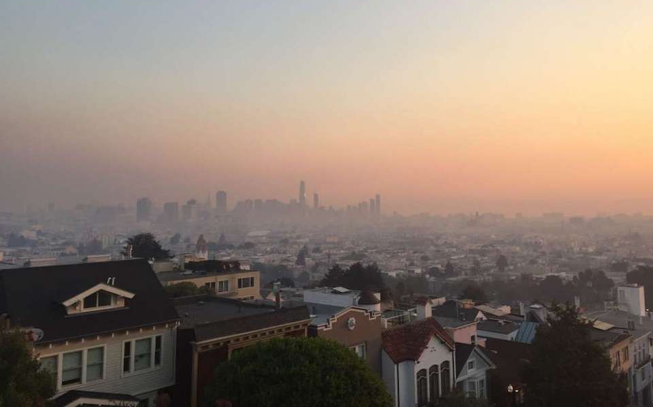
Governance Challenges
Creating a sense of urgency
Hard to understand and communicate what resilience means and how its measured
Requires tools to develop and implement long term solutions in a political environment
Problems and solutions go beyond jurisdictional boundaries
Focus on life-safety and short-term response rather than long-term recovery
Issues of equity, displacement, housing, demographics, and population growth
Ability to support or compel the private sector
Lack of funding for planning, mitigation and implementation
Changing conditions
Public Confidence

Slide 4
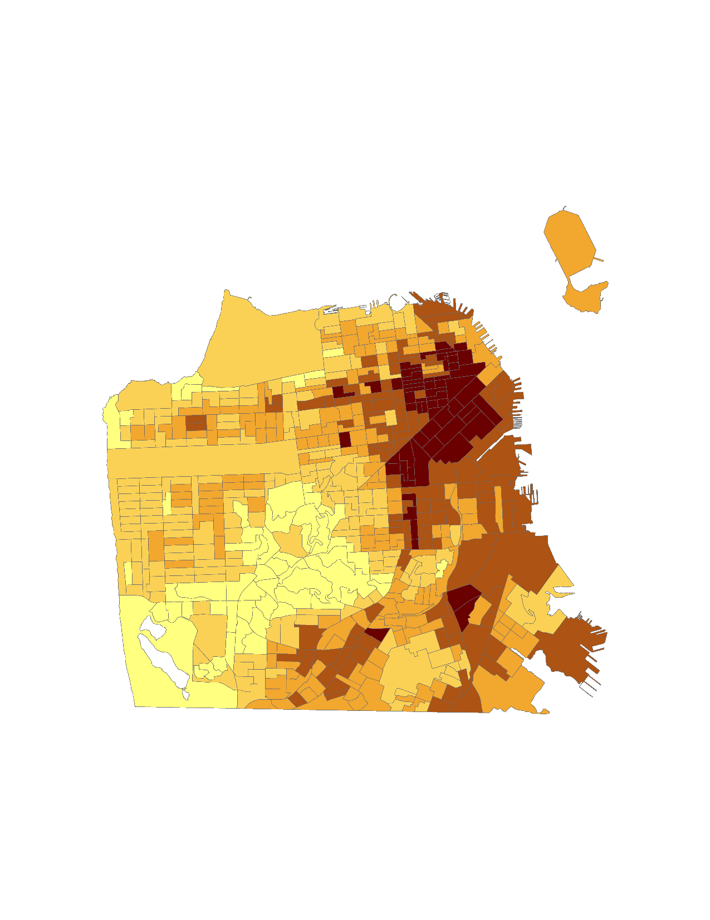
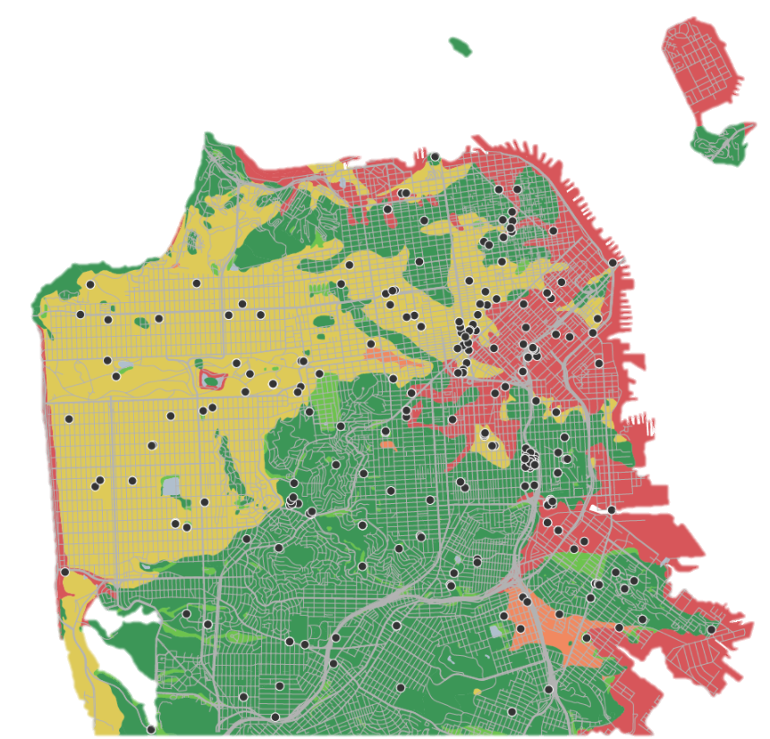
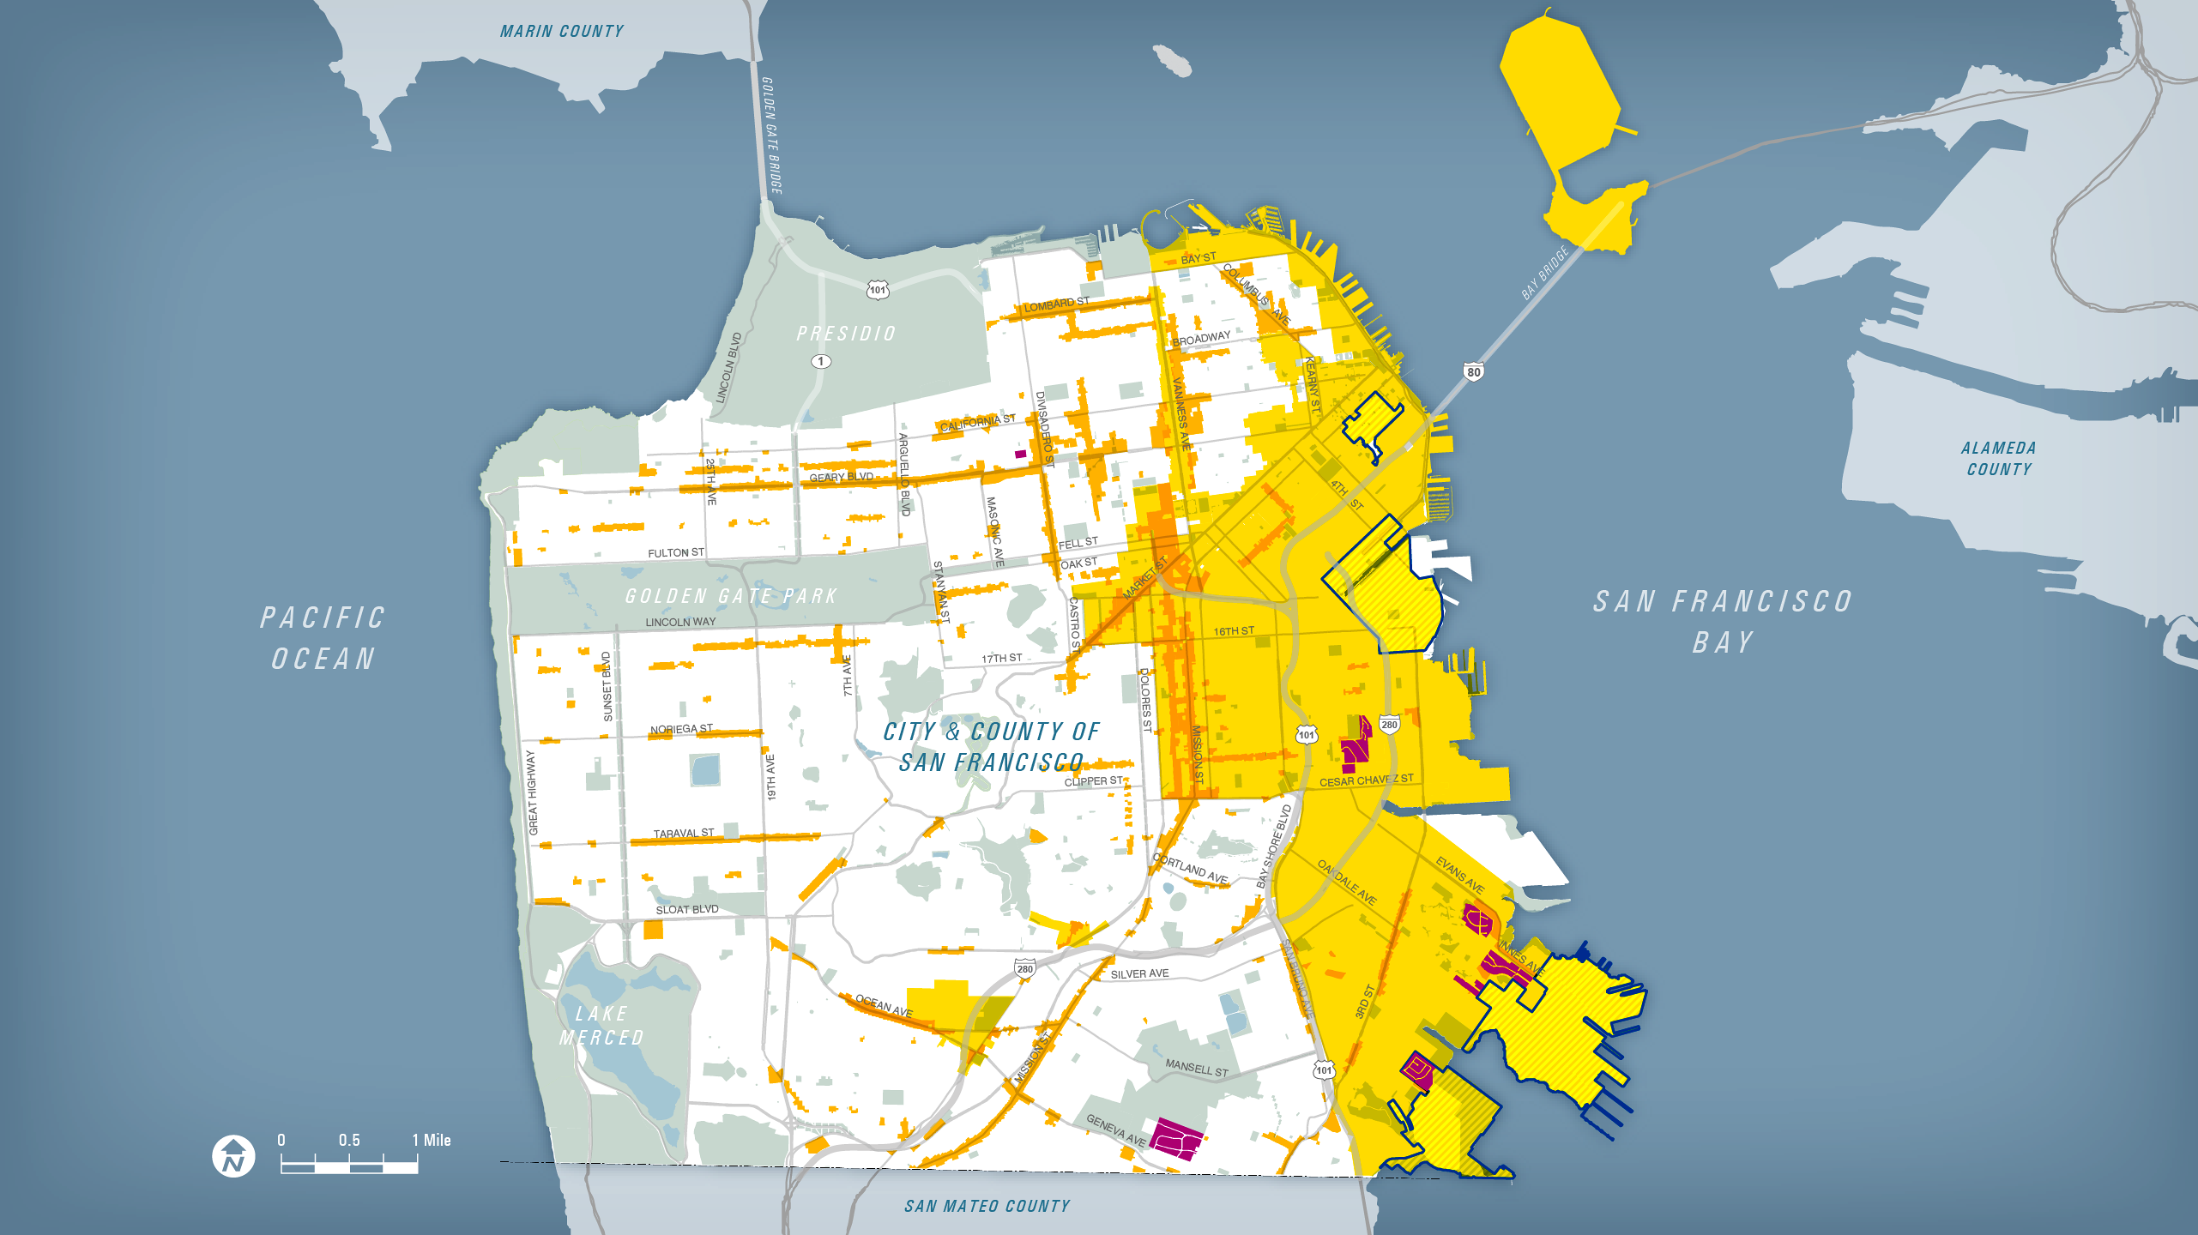
Resilience Challenges
1.1 million people
by 2040.
Climate Change Social Vulnerability Indicators by Census Block
Age
Race and ethnicity
Poverty
Educational attainment
Linguistic isolation
Health status
Liquefaction
Zones
Plan Areas and Commercial Corridors
Redevelopment
Hope SF
Notes:
While we face many challenges, three that I want to highlight at the onset are social along the lines of population growth and vulnerable communities and the other is liquefaction.
-25% population growth all along the edge of the Bay in the southeast—growth is transient…the churn
-Vulnerable populations are concentrated in the same area, though we are also experiencing a doubling of our seniors and other areas across the city…this map focuses on
Age
Race and ethnicity
Poverty
Educational attainment
Linguistic isolation
Health status
-Liquefaction speaks for itself…

Slide 5
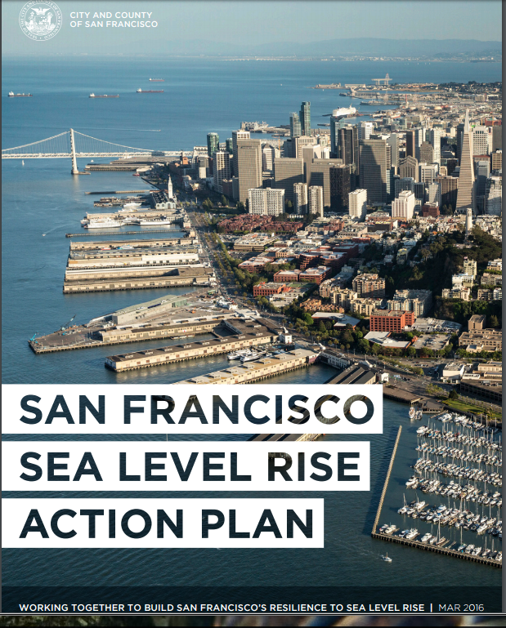
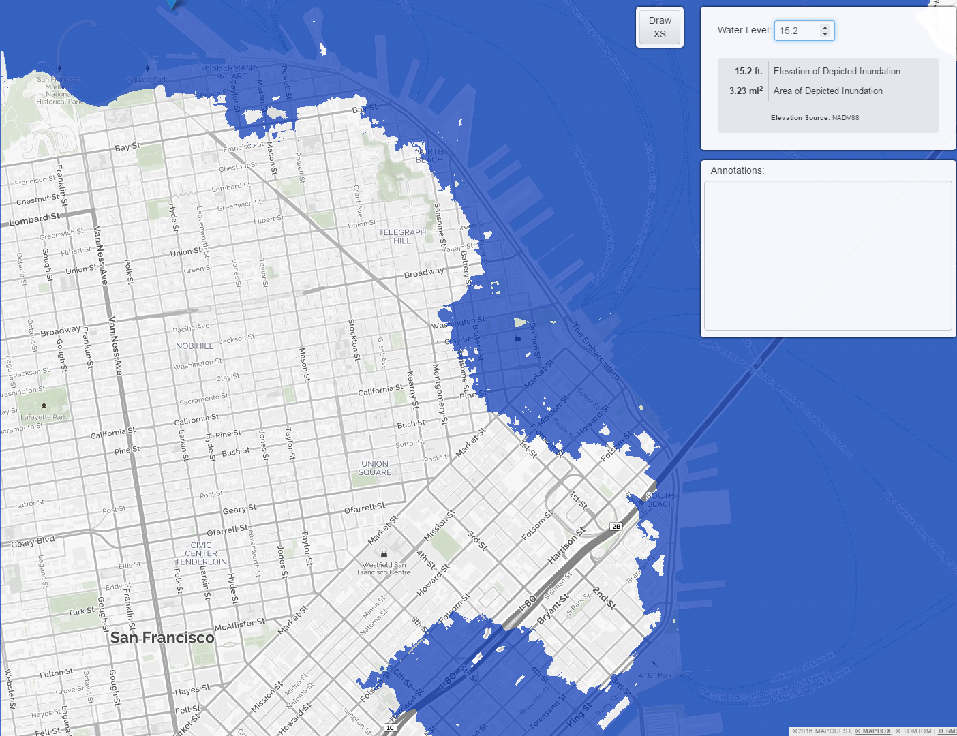
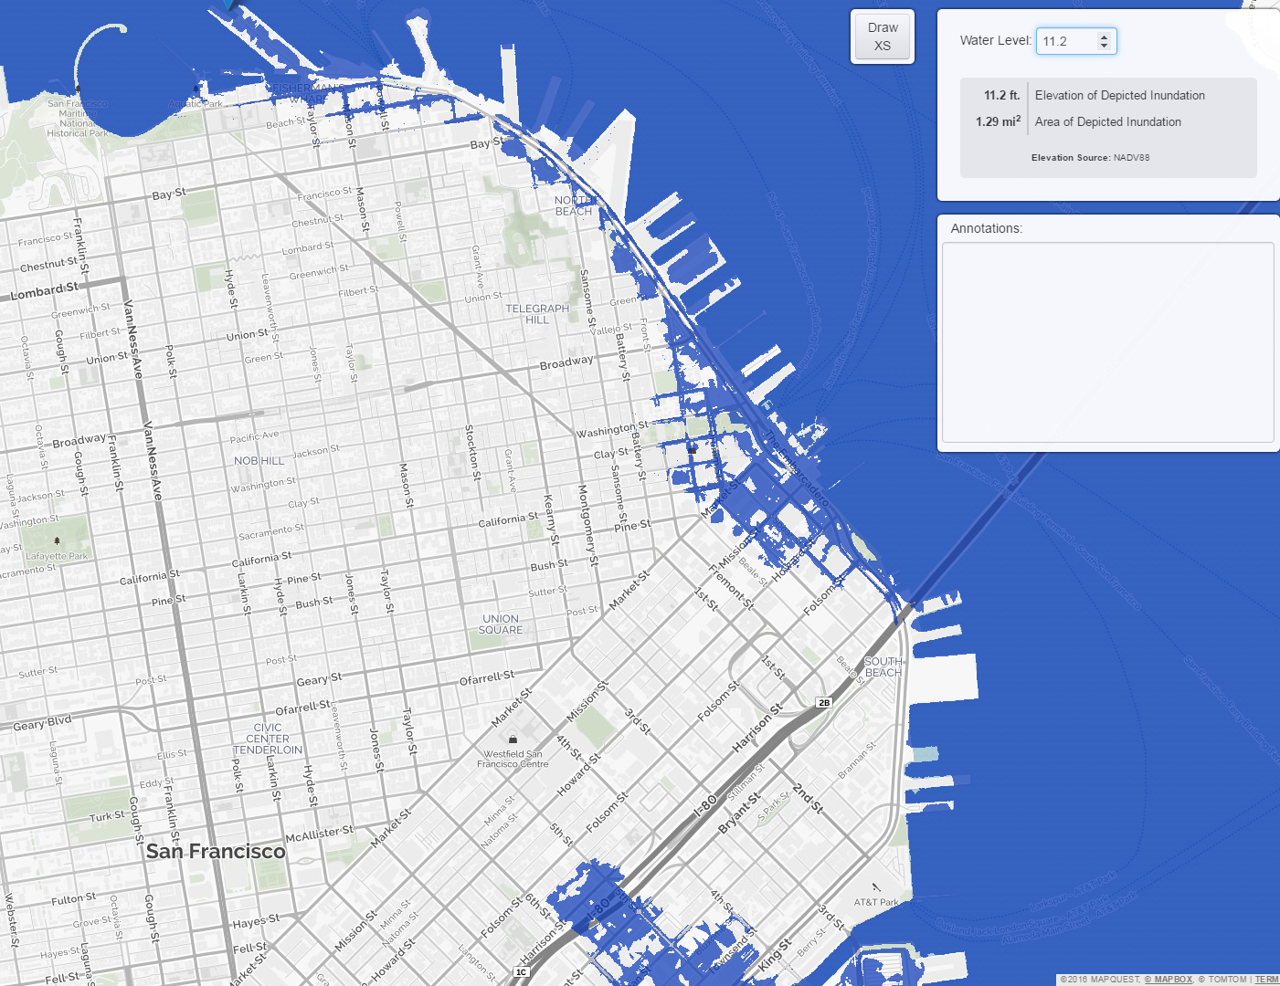
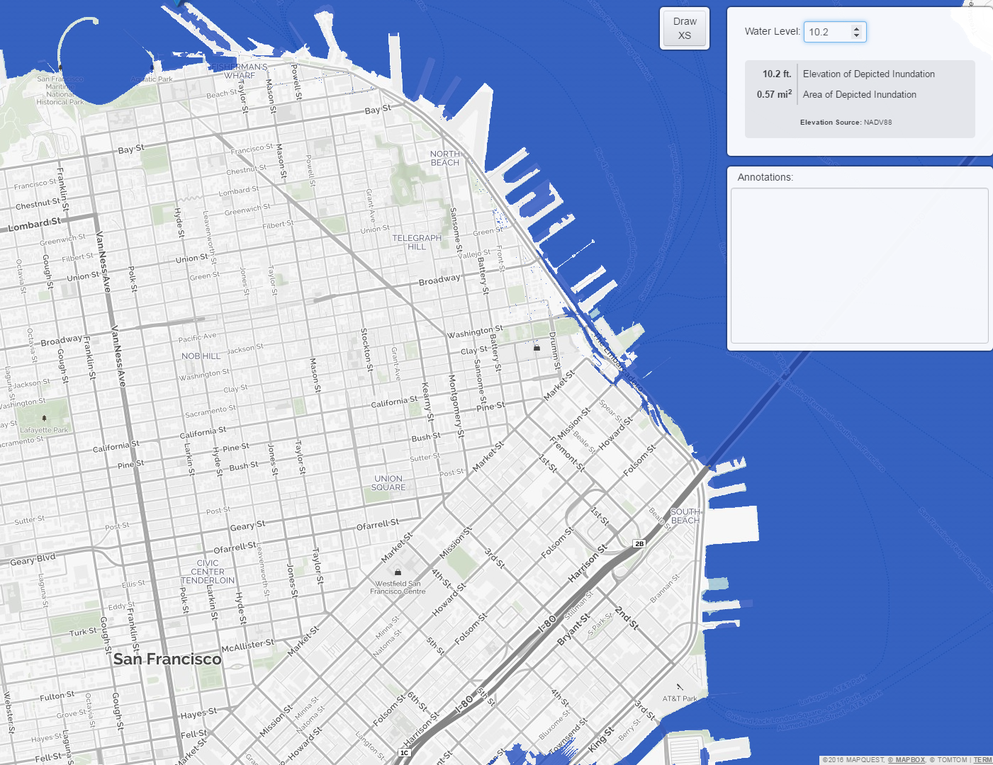
Resilience Challenges
High Scenario
108” in 2100
High Scenario
66” in 2050
Existing Waterfront
Fisherman’s Wharf and all piers
BART/Muni Tunnel
Embarcadero Station
Year 2100 | Private Property | Public Property | Total Exposure
66” (SLR) | $19 Billion | $35 Billion | $54 Billion
108” (SLR + stormsurge) | $38 Billion | $37 Billion | $75 Billion
Note: Dollar amounts indicate asset replacement cost only. Numbers are in 2016 dollars and reflect upper range, end-of-century projections without adaptation or action.
5
Notes:
City developed an action plan in 2017 and is currently developing a long term SLR Strategy. The implications are huge under what we could be facing. Citywide interagency cooperation and data vetting through a SLR Vulnerability and Consequence Assessment that will lead to a broader action plan.

Slide 6
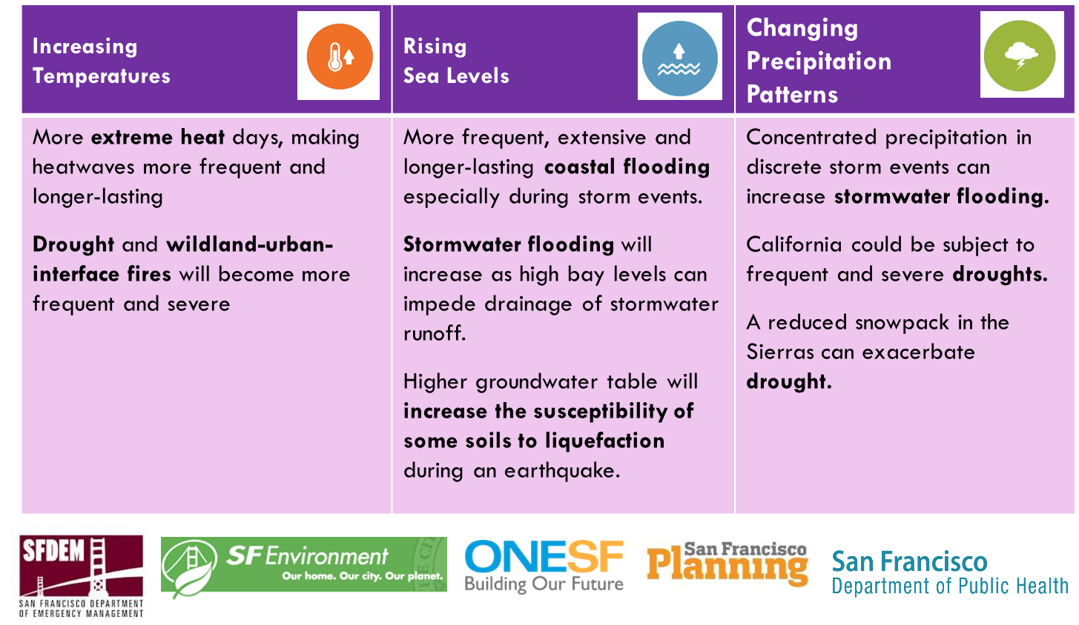
Resilience Planning
Notes:
ReslientSF, HCR, Climate Action Plan, SLR Guidance, SLR Action Plan, ESIP, etc.
Compliance with FEMA, SB 379, C40 Commitment
Direction setting for future capital planning, area planning, policy and program development
Greater alignment – bringing departmental hazard mitigation and climate adaptation work under a citywide framework
Greater community support for taking action to reduce hazard and climate risks

Slide 7
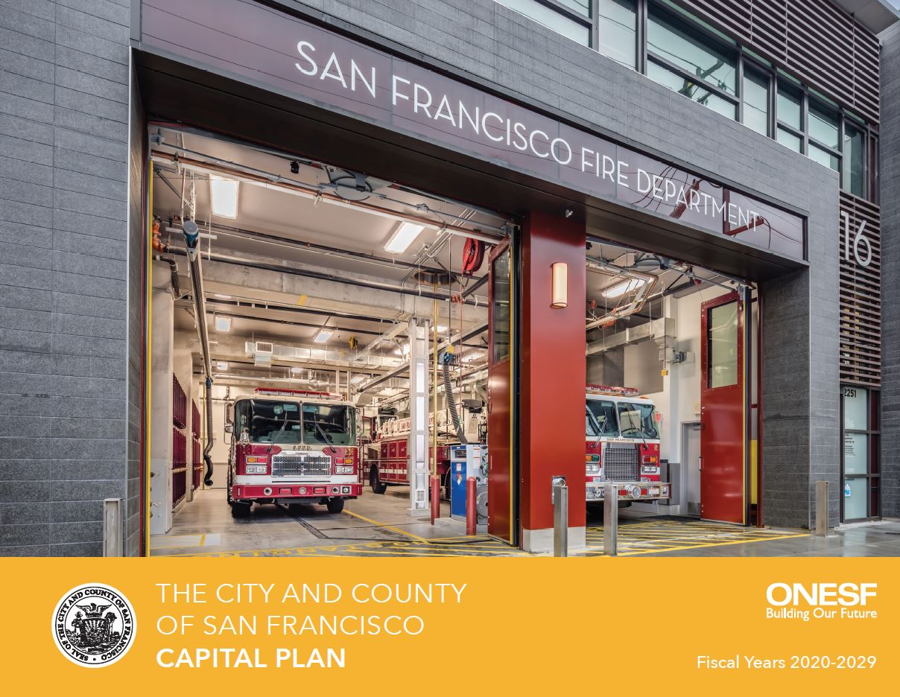
Financial Policies
  10-Year $39 billion Capital Plan
  Constrained 10-Year Plan of finance for all infrastructure
  Objective and transparent process
  Emphasizes resilience and sustainably
  Capital Planning Fund
  5-Year Financial Plan
  Captures all operating expenses
  Identifies and addresses on-going obligations (pension/OPEB/state of good repair, etc.)
  Strong budget reserves and access to credit
  Contributes to AAA credit
7

Slide 8
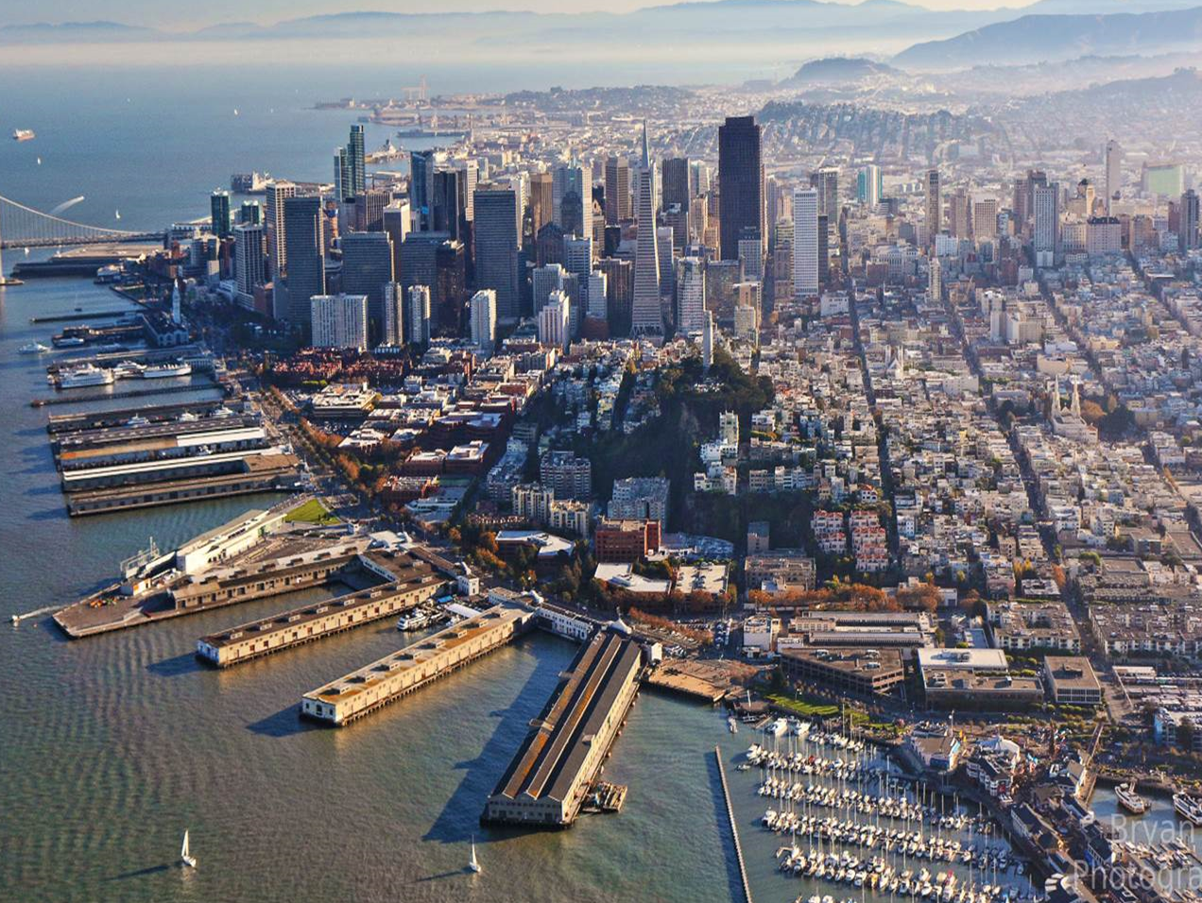
San Francisco
Seawall
At Risk
$100 billion in assets
and activities
Historic district
Maritime facilities
Bart/Muni railway
Utilities
Emergency response role
Estimated Costs
$500M for immediate life safety and some flooding
$2.0B Remaining seismic needs
$2.5B SLR needs
Photo | Michael Macor
Notes:
Today, San Francisco’s Bay waterfront is a vital part of the City’s identity. A major earthquake could produce serious damage along the waterfront that could have major ramifications for the City’s recovery and economy.
A major, local seismic event could irreparably damage the Embarcadero Historic District.
This area is a major economic contributor, with $2.1 bill/year in Port rent, business income, wages is at risk.
The maritime industry, including ferries, is expected to play a major role in earthquake recovery – subject to continued access.
Damaged utilities along the seawall leading to loss of water, sewer, power and gas services to waterfront and portions of the City.
The Embarcadero will serve as a vital point of exit for hundreds of thousands of Downtown workers, to clear debris from Downtown and deliver supplies to the City.
The Embarcadero will play a pivotal role post-disaster, helping people from downtown exit the City, providing staging areas to receive supplies and remove debris, and permitting access to downtown for first responders. The existing auxiliary water supply system is fed through intakes that enable the flow of water supply from San Francisco Bay.

Slide 9
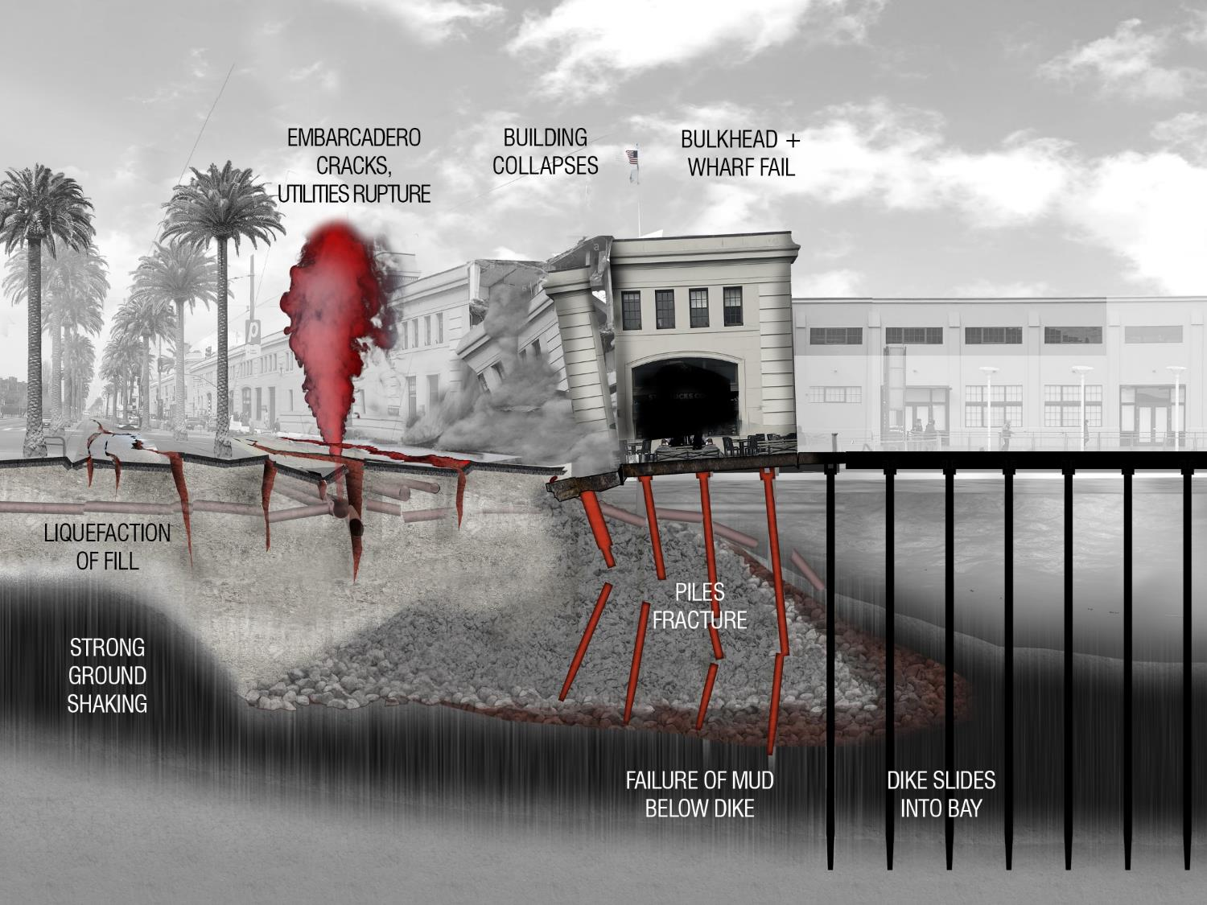
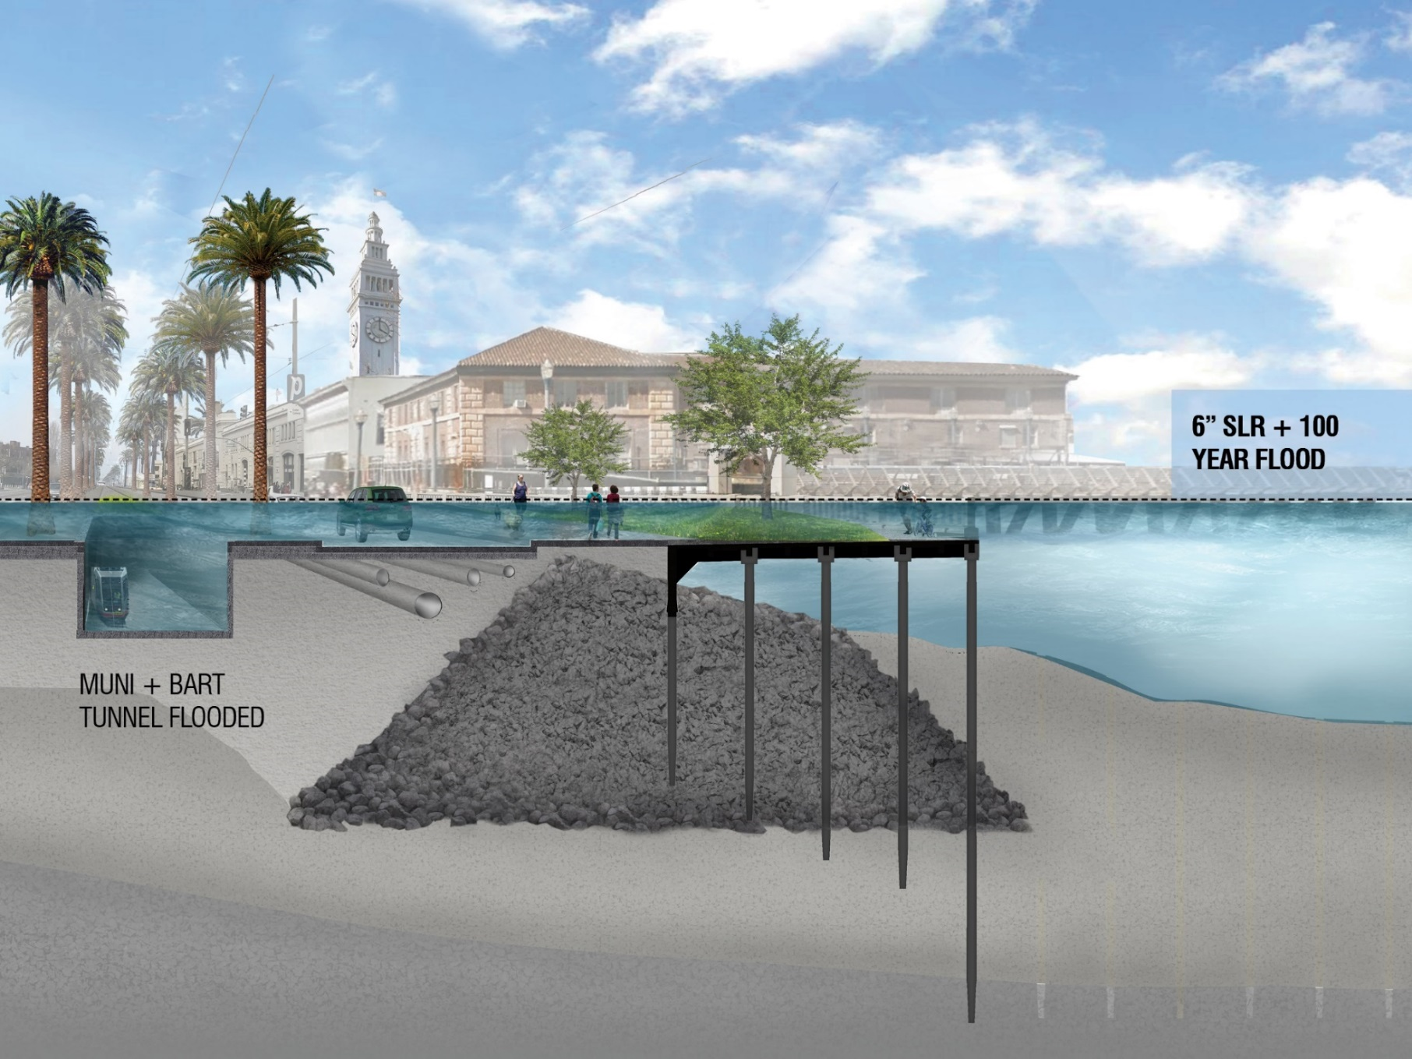
San Francisco Seawall
$425M GO bond passed in November 2018 with 82% support
Selected as a “New Start” by US Army Corps of Engineers
Materials and video can be found at: https://sfseawall.com/
Notes:
In a major seismic event, strong ground shaking is expected to cause the fill behind the seawall to liquefy, increasing pressure and causing the Seawall to move bayward of several feet.
This type of movement will fracture piles supporting historic bulkhead walls and wharves, rupture utilities, and damage surface structures including the Promenade, Roadway, and Light Rail tracks.

Slide 10
Seawall Finance Working Group
48 Revenue Source Considerations
Rank | Funding Strategy | Source of Funds | Revenue Generating Potential *** | Cost of Funds | Long Term Sustainability | Flexibility of Funds | Timing | Tradeoffs for Other City Needs | State/Federal Political Feasability | Local/Regional Political Feasability | Administrative Complexity | Equity/Cost Burden | Weighted Average
1 | Local Property Tax Increment from IFDs | 5 | 5 | 5 | 4 | 5 | 5 | 4 | 5 | 5 | 4 | 5 | 4.77
2 | Community Facilities District (CFD) | 5 | 5 | 5 | 5 | 5 | 3 | 4 | 5 | 3 | 3 | 5 | 4.46
3 | USACE – CAP 103 Program | 5 | 5 | 4 | 3 | 3 | 5 | 5 | 4 | 5 | 3 | 5 | 4.38
4 | State Property Tax Increment from IFDs | 5 | 5 | 3 | 5 | 5 | 3 | 4 | 3 | 5 | 3 | 5 | 4.31
5 | General Obligation (G.O.) Bonds | 5 | 5 | 5 | 5 | 3 | 3 | 2 | 5 | 3 | 5 | 4 | 4.23
6 | Cap & Trade Program Funding | 5 | 5 | 5 | 3 | 3 | 5 | 3 | 3 | 3 | 5 | 5 | 4.23
7 | State Resilience G.O. Bond | 5 | 5 | 5 | 5 | 3 | 3 | 4 | 3 | 3 | 4 | 5 | 4.23
8 | Sales Tax Increase | 5 | 5 | 5 | 5 | 5 | 3 | 1 | 5 | 2 | 5 | 3 | 4.15
9 | Hotel Assessment | 5 | 5 | 4 | 3 | 5 | 3 | 2 | 5 | 2 | 4 | 5 | 4.08
10 | Increased Parking Revenues | 5 | 5 | 5 | 3 | 3 | 3 | 2 | 5 | 1 | 5 | 5 | 4.00
11 | Assessment District | 5 | 5 | 5 | 5 | 5 | 3 | 3 | 4 | 1 | 1 | 5 | 4.00
12 | USACE – General Investigation | 5 | 5 | 5 | 5 | 3 | 1 | 3 | 3 | 3 | 2 | 5 | 3.85
13 | Philanthropy | 5 | 2 | 5 | 2 | 5 | 2 | 4 | 5 | 5 | 5 | 5 | 3.77
14 | Historic Tax Credits | 5 | 3 | 5 | 2 | 1 | 3 | 5 | 5 | 5 | 4 | 5 | 3.77
15 | Tax/Fee on Marina Uses | 5 | 1 | 5 | 5 | 5 | 5 | 3 | 5 | 1 | 5 | 5 | 3.62
16 | Cruise Tickets Surcharge Increase | 5 | 1 | 3 | 5 | 5 | 3 | 5 | 5 | 4 | 4 | 4 | 3.54
17 | Advertising | 5 | 1 | 2 | 3 | 5 | 5 | 5 | 5 | 2 | 5 | 5 | 3.46
18 | RM3- Bridge Tolls Program | 5 | 5 | 5 | 5 | 3 | 2 | 1 | 1 | 2 | 3 | 3 | 3.46
19 | Vehicle License Fee (VLF) Increase | 5 | 3 | 3 | 2 | 5 | 3 | 1 | 5 | 1 | 5 | 5 | 3.38
20 | Parcel Tax | 5 | 3 | 5 | 2 | 5 | 3 | 2 | 5 | 2 | 5 | 1 | 3.38
21 | Naming Rights | 5 | 1 | 5 | 2 | 5 | 4 | 4 | 5 | 2 | 3 | 5 | 3.31
22 | Congestion Pricing | 5 | 5 | 3 | 5 | 3 | 2 | 2 | 2 | 1 | 1 | 2 | 3.15
23 | Public Private Partnerships (P3s) | 1 | 4 | 1 | 3 | 5 | 3 | 5 | 4 | 1 | 3 | 2 | 3.08
24 | Utility User Tax Surcharge | 5 | 3 | 2 | 3 | 5 | 2 | 1 | 3 | 1 | 4 | 3 | 2.92
25 | Transit Impact Development Fee | 5 | 1 | 1 | 3 | 2 | 5 | 1 | 5 | 2 | 4 | 5 | 2.77
26 | Federal Transportation Funding - TIFIA | 3 | 4 | 3 | 3 | 3 | 1 | 2 | 1 | 3 | 1 | 4 | 2.77
27 | Real Estate Transfer Tax Increase | 3 | 3 | 3 | 3 | 3 | 3 | 1 | 5 | 1 | 1 | 3 | 2.69
28 | Surcharge on Event Tickets | 4 | 1 | 1 | 3 | 4 | 3 | 2 | 5 | 1 | 5 | 3 | 2.62
29 | Environmental Impact Bonds | 5 | 1 | 3 | 2 | 4 | 2 | 2 | 5 | 2 | 2 | 4 | 2.62
30 | Sale/Lease Increment of Port Assets | 2 | 2 | 3 | 4 | 5 | 2 | 1 | 1 | 1 | 5 | 4 | 2.62
31 | Regional Gas Tax | 3 | 4 | 1 | 1 | 3 | 2 | 1 | 2 | 1 | 3 | 3 | 2.46
32 | Increased Ferry Charges | 5 | 1 | 1 | 2 | 4 | 2 | 3 | 2 | 1 | 4 | 3 | 2.31
33 | Hazard Mitigation Grants | 5 | 1 | 3 | 1 | 1 | 1 | 3 | 1 | 3 | 4 | 5 | 2.31
34 | Pension Plan Investment | 2 | 3 | 3 | 1 | 4 | 1 | 2 | 1 | 2 | 2 | 3 | 2.31
35 | Geologic Hazard Abatement Districts | 3 | 1 | 1 | 3 | 4 | 1 | 4 | 3 | 1 | 1 | 5 | 2.23
36 | Infrastructure Trust Bank | 4 | 2 | 1 | 1 | 3 | 2 | 2 | 1 | 1 | 1 | 4 | 2.00
37 | Transit Pass Transfer Fee | 1 | 1 | 1 | 1 | 1 | 1 | 1 | 1 | 1 | 1 | 1 | 1.00
38 | Resilience Bonds/Insurance Value Capture | 1 | 1 | 1 | 1 | 1 | 1 | 1 | 1 | 1 | 1 | 1 | 1.00
Revenue Generating Potential
Timing
Administrative Complexity
Political Feasibility
Cost Burden
Notes:
After the heat map was created, the group also critically analyzed the top-rated sources in follow-up discussions to ensure the usefulness of the scoring process
The SFWG reviewed the results with the following 5 high-level considerations in mind:
Revenue Generating Potential: How much revenue can this funding strategy realistically offer the Project given how long the funding source can last?
Timing: When will funds from this strategy become available?
Administrative Complexity: How complicated will it be to implement this strategy and is it under City control?
Political Feasibility: How likely is it that this strategy can be passed at the federal, state, regional, and/or local level?
Cost Burden: As a set of recommendations, are we distributing the Seawall’s cost equitably among all those who rely upon it: residents, businesses, visitors, the Bay Area regionally, the State of California, and the U.S. federal government?

Slide 11
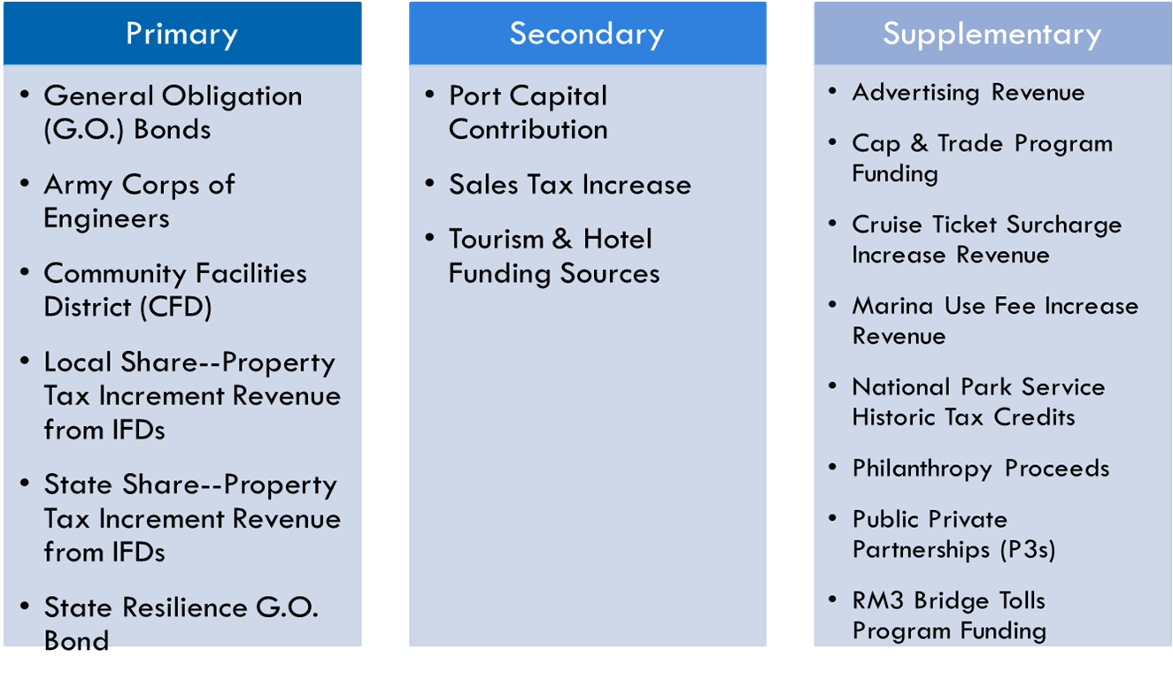
Seawall Finance Working Group
Revenue recommendations:
Notes:
From there the group created our recommendations
The group decided to recommend 17 sources, 9 of which could produce meaningful proceeds for the Project.
These recommendations are organized in 3 sets of recommended funding sources:
6 primary recommendations that the Port and the City should immediately pursue
3 secondary recommendations that could also produce meaningful proceeds for the Project
8 supplementary recommendations that have low revenue potential or political feasibility but are related to the Project and still worth pursuing
I will now dive into each of the recommendations. Just note, they are not presented in any priority order, just in alphabetical order. The only exception is the G.O. Bond strategy, which is presented first because the Port and the City are already in process of pursuing this strategy.

Slide 12
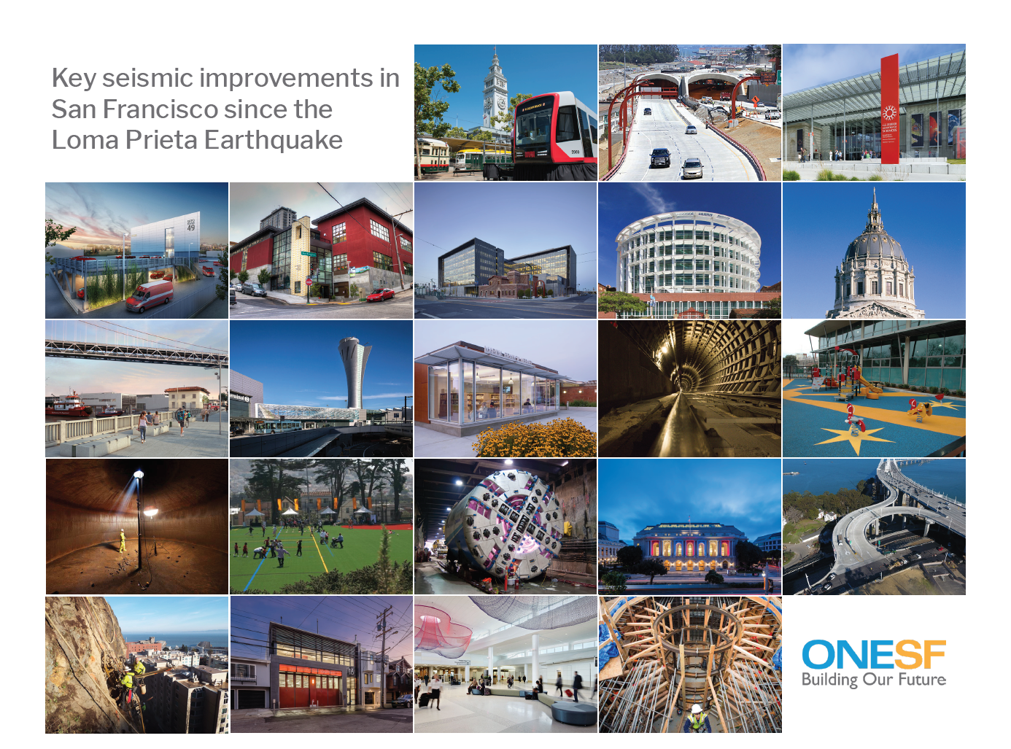
Thanks!
Questions?
You can find me at:
Brian.Strong@sfgov.org

