Slide 1
California Society of Municipal Analysts: ESG Integration and Social Impact Investing
Ksenia Koban
Vice President
Municipal Strategist
(213) 830-4684
kkoban@payden.com
November 7, 2019

Slide 2
TABLE OF CONTENTS
Our Investment Process
Why does Payden include climate resilience in its fundamental analysis?
Municipal Social Impact Assessment Framework
Other Key Investment Attributes of Resilience Projects
Sample Bond Deal
I
II
III
IV
V

Slide 3
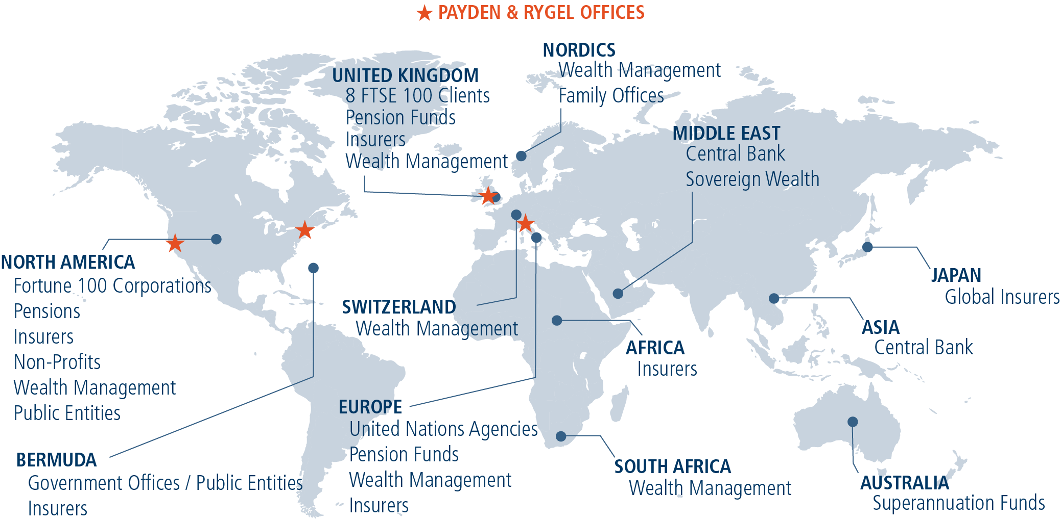
OUR FIRM
OUR CULTURE
ESTABLISHED IN 1983
Los Angeles-based, offices in Boston, London, Milan
OVER $114 BILLION AUM
A fully-resourced – yet flexible – firm
ONE GOVERNANCE CENTER
Clients have direct access to business owners
100% EMPLOYEE OWNED
21 Shareholders, 25+ yrs avg tenure of senior leaders
GLOBAL PERSPECTIVE ON INVESTING
Regardless of benchmark
COLLABORATIVE APPROACH
Sharing best ideas, constructive debate
EXCEPTIONAL RETENTION
of talented people and clients
ALIGNMENT OF INTERESTS
Fully focused on our clients
OUR GLOBAL REACH

Slide 4
One Page on Payden & Rygel’s ESG Activity and Commitment
Past …
UN PRI Signatory since 2013
Three years of reporting, including all fixed-income modules
History of both exclusionary and inclusionary risk assessment on behalf of our clients
Conduct industry-specific, business-relevant risk analysis
Implement NGO/government-required, and regulatory restrictions in portfolios
… Present …
One of a small number of asset manager SASB Alliance members
Active buyer of green and social bonds across both ESG and standard client assignments
Provide customized ESG-indicator-level, portfolio-specific reporting for existing and prospective clients
SASB standards in investment process, publish work in SASB’s ESG Integration Insights in Q2 2017
Manage large existing mandates with explicit ESG integration across the fixed income universe
Advise on ESG strategies inside and outside the firm
… and Future
Rapid growth in interest from European and Australian pensions, NGOs, and more recently U.S. corporations
Continue expansion of ESG resources and team

Slide 5
Payden’s Social Impact Investment Process
I
Investment Philosophy
We believe that total return and social impact mandates are not mutually exclusive; that investors can actively seek to promote social and environmental benefits without sacrificing total return performance
Fundamental Research
Apply rigorous fundamental analysis across standard and proprietary qualitative and quantitative metrics
Continuously monitor and evaluate the municipal landscape for impact investment opportunities, including issuer outreach and market cultivation
Systematically assess credit profile against specific sector and municipal market trends
Valuation Assessment
Evaluate security structural elements (yield/income/duration) for “best fit,” liquidity characteristics, and total return potential
Consider tax-adjusted yield, sector/name diversification and volatility, and liquidity profile attributes
Conduct scenario analysis to project expected security returns
Social Impact Assessment
Systematically evaluate issuer/project within the municipal social impact framework to achieve a stand-alone project score
Collect, analyze, and integrate relevant data, technical reports/studies, and disclosure materials for selected securities
Engage with issuer frequently, and third party verifiers or evaluators when necessary or beneficial
Portfolio Management and Ongoing Monitoring
Monitoring of risk indicators and performance attribution consistent with firm and strategy-wide practices (i.e., positive alpha contribution, stable credit trajectory, duration and sector allocation continue to fit portfolio strategy)
Strict application of reporting and disclosure standards on all relevant criteria within the social impact framework
Periodic re-evaluation of stand-alone social impact score for inclusion

Slide 6
Why does Payden include climate resilience in its fundamental analysis?
II
We understand the threats that climate related events and developments pose to state and local governments’ core operations, public and private assets, and essential services.
We assess all risks that may threaten or disrupt the normal course of business operations. Even those that may not be quantifiable or show up on financial statements, but may nevertheless have material long-term impact on municipal, or project performance.
Good governance and long-term planning are key metrics in our credit and impact assessment frameworks.
We view effective resilience, sustainability, and adaptation projects as evidence of strong management practices that seek to mitigate/neutralize negative climate related outcomes.
We seek to invest in projects and local governments that are identifying these threats early, building effective capital programs to counter them, and are committed to transparency and disclosure.

Slide 7
Municipal Social Impact Assessment Framework
III
Nature and Attributes of Impact
(30%)
Deliberation, Governance and Engagement
(40%)
Targeted Impact Enhancement
(30%)
Overall Social Impact Score
Issuer/Project alignment:
Determination of alignment with UN SDG and Green and/or Social Bond Principles
Identification of impact area or relevant principle
Use of Proceeds:
Clear description and understanding of intent, relevance, and proceeds application
Qualitative and quantitative assessment of project details by issuer
Expression of commitment to achieving said goals
Deliberative Approach:
Understanding of relevant ESG risks and opportunities and issuer role in mitigation
Codified statutes, ordinances, policy initiatives, LT financial/capital plans, operational goal integration etc.
Third party certifications, designations, and scores
Strong Governance:
Prudent management and segregation of proceeds
Sustainable fiscal profile
Investor Engagement:
Commitment to reporting and disclosure
Receptiveness to inquiry
Principal Impact Sectors:
Energy and Essential Utilities; K-12 and CCDs; Health and Soc. Services; Economic Opportunity; Affordable Housing; Sustainable Transportation; Resource Recovery; Disaster Recovery
Geographic and/or socioeconomic relevance:
Alignment of transaction proceeds with geographically and/or socioeconomically high impact area or social purpose
Assessment of select sector specific ESG criteria
High Score:
Issuer/project meets most of the criteria within framework pillars to achieve high score on the factor
Moderate Score:
Issuer/project meets many of the criteria within framework pillars to achieve moderate score on the factor
Low Score:
Issuer/project meets some of the criteria within framework pillars to achieve low score on the factor

Slide 8
What we MUST see in a resilience/adaptation project
IV
Clear Project Scope and Objective
Use of Proceeds is clearly stated and descriptive of the relevant characteristics of the project (ex: resilience/adaptation components and their quantifiable/identifiable impact)
Adherence to Green/Social Bond Principles
Project aligns with one of the GBP high level categories and is adequately described
Transparency and Engagement
Traditional financial disclosure requirements are met. Additional quantification of project impact and outcomes is at least estimated.
Conforming Deal Structure and Features
Project and its financial elements must have comparable structural attributes to traditional debt/investment instruments.
Estimate of financing vs. re-financing, specific projects are identified, and proceeds are tracked or segregated.
Must have features that are reflective of market environment and are additive to performance.
Some financial/progress reporting over the life of the project

Slide 9
What we LIKE to see in a resilience/adaptation project
IV
THIRD PARTY INPUT
Third party certification/score
Statutory self-designation
Use of national/global project development criteria (ex: Enterprise Green Communities Criteria)
DATA & ANALYTICS
Strong relationship with data and technology
Non-financial information that can affect financial performance
Sharing of information and progress
STRONG GOVERNANCE
Thorough and Productive stakeholder engagement
Robust contractual frameworks
Investor protections that minimize policy risks (ex: perfected liens, bond covenants, security package etc.)
Effective distribution of risks
BEST PRACTICES IN ACTION
Evidence based understanding of environmental impact and effective response
Thorough Project Evaluation
Mitigation vs. Response ($1 of mitigation is worth $8 of response)
Who’s doing it better/smarter? (ex: Smart Cities Challenge Grants)

Slide 10
V
Revenue Bond
San Francisco Public Utilities Commission – Wastewater Green Revenue Bonds
Issuer/Issue Description
The SFPUC wastewater enterprise, which provides sewage and storm water collection, treatment and disposal to San Francisco residents, is issuing CBI and Sustainalytics certified Green Bonds to finance its large Sewer System Improvement Plan, including the construction of a Biosolids Digester Facilities Project, also partially funded with an EPA loan. Other projects include replacing aging and inefficient facilities, upgrades, and new treatment plants. The bonds are secured by senior lien on net revenues of the system. The PUC's service area is largely coterminous with the City of San Francisco
Security Features
Sector: Water/Waste Utility Revs
Maturity: 10/01/2048
Call/Put Provision: Par Call 4/1/23; Put 10/1/23
Price/Yld at Issue: 100.0/2.125
Issue Spread: +21/BVAL
Bond Rating: Aa3/AA
CUSIP: 79768HDZ8
Social Impact Score: HIGH
Investment Attributes | Status/Description
Project Scope and Use of Proceeds | Wastewater treatment and management projects that include system replacement, upgrades, storm surge, and rising sea level mitigation and adaptation. Includes Biosolids Digester Facilities Project.
GBP Category and Alignment | Sustainable water and waste-water management: Infrastructure for wastewater treatment, sustainable urban drainage systems or flooding mitigation. Climate Bond Certified Green Bonds; Third party verified by Sustainalytics
Governance and Transparency | Management proactively incorporates climate risk into capital planning and budgeting SFPUC commits to working with investors and certification entities on ongoing disclosure and project monitoring.
Credit Profile | Strong enterprise profile, as well as environmental compliance and rate-setting practices Solid economic fundamentals, and strong financial risk profile relative to industry and peers
Deal Structure and Relative Value | Attractive five-year call/put structure with a high penalty adj. rate in case of failed mandatory tender Large issue size; liquid, widely held CA issuer with stellar investor reputation Tight spread relative to comparable peers, unlikely alpha contributor.

Slide 11
SI Assessment Scorecard
San Francisco Public Utilities Commission Wastewater Revenue Green Bonds, Series C 2018
 |  | SFPUC Wastewater Green Bonds | High
Factor | Sub-Factor | Analysis | Weight | Score
Nature and Attributes of Impact | Issuer/Project Alignment | GBP category: Sustainable water and waste-water management Wastewater treatment and management projects that include system replacement, upgrades, storm surge, and rising sea level mitigation and adaptation. Includes Biosolids Digester Facilities Project | 30% | High
 | Use of Proceeds
Deliberation, Governance and Transparency | Deliberative Approach | Management proactively incorporates climate risk into capital planning and budgeting Climate Bond Certified Green Bonds; Third party verified by Sustainalytics SFPUC commits to working with investors and certification entities on ongoing disclosure and project monitoring Provides quarterly sewer system improvement progress reports Maintains a regular community outreach program (meetings and social media info sharing) SFPUC maintains a robust and well-populated investor relations website, and is very receptive to inquiry and investor engagement opportunities. | 40% | High
 | Prudence and Transparency
 | Investor Engagement
Targeted Impact Enhancement | Principal Impact Sector | Essential Utilities: upgrading the aging combined sewer system with a mix of grey and green infrastructure projects and technology. State of CA has conducted several regional climate change assessments and produced technical reports and evidence-based scenario analysis that expose and quantify Bay Area vulnerabilities to excessive flooding, rising temperatures and sea levels, intensifying droughts and/or variable precipitation and wildfires. Wastewater plants are especially vulnerable in the region due to salinity intrusion and subsurface flooding | 30% | High
 | Geographical or Socioeconomic Need Assessment

