Slide 1
California’s Budget Situation
2019 CSMA Fall Conference
November 7, 2019

Slide 2
General Fund Condition Summary

Slide 3
How the 2019-20 Budget Package Allocates a $21.5 Billion Surplus

Slide 4
Debt and Liability Payments

Slide 5
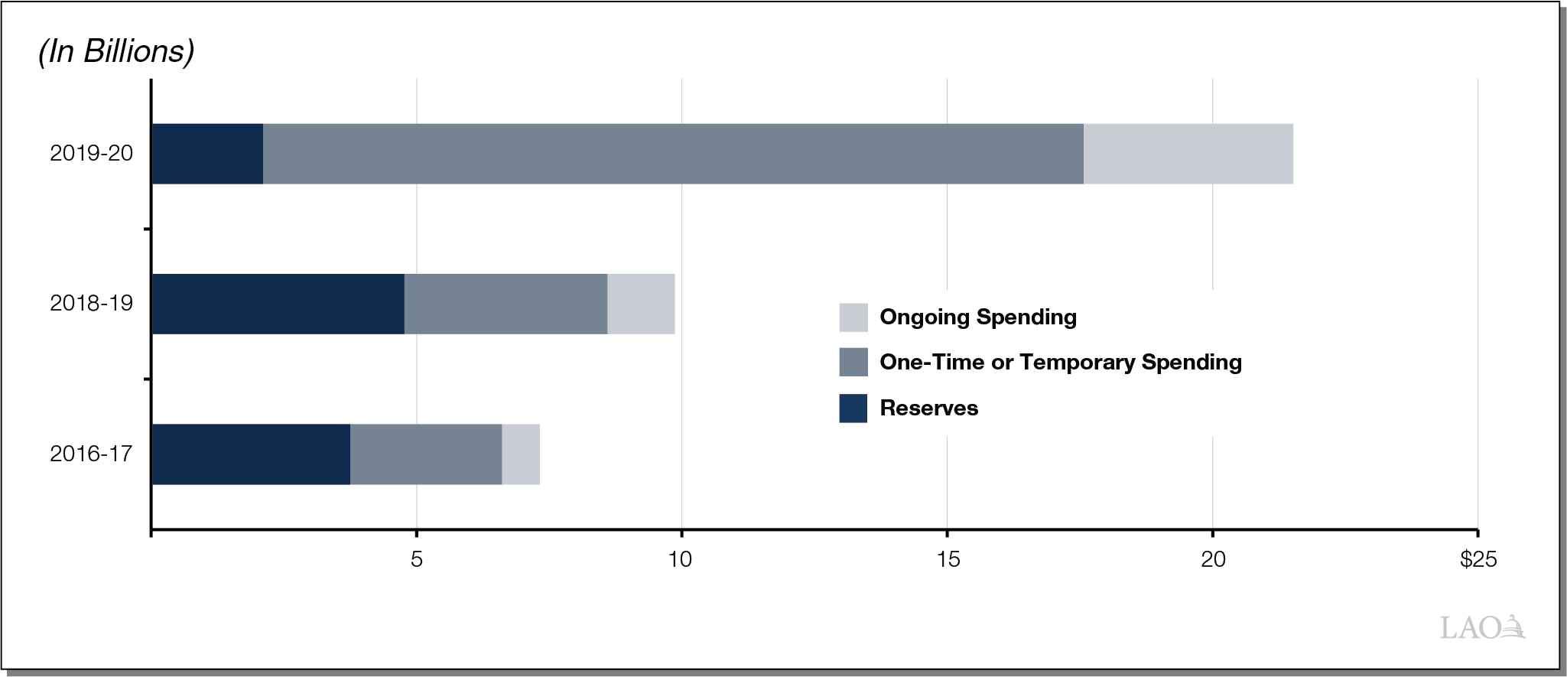
How Recently Enacted Budgets Have Allocated the Available Surplus

Slide 6
Major Programmatic Spending

Slide 7
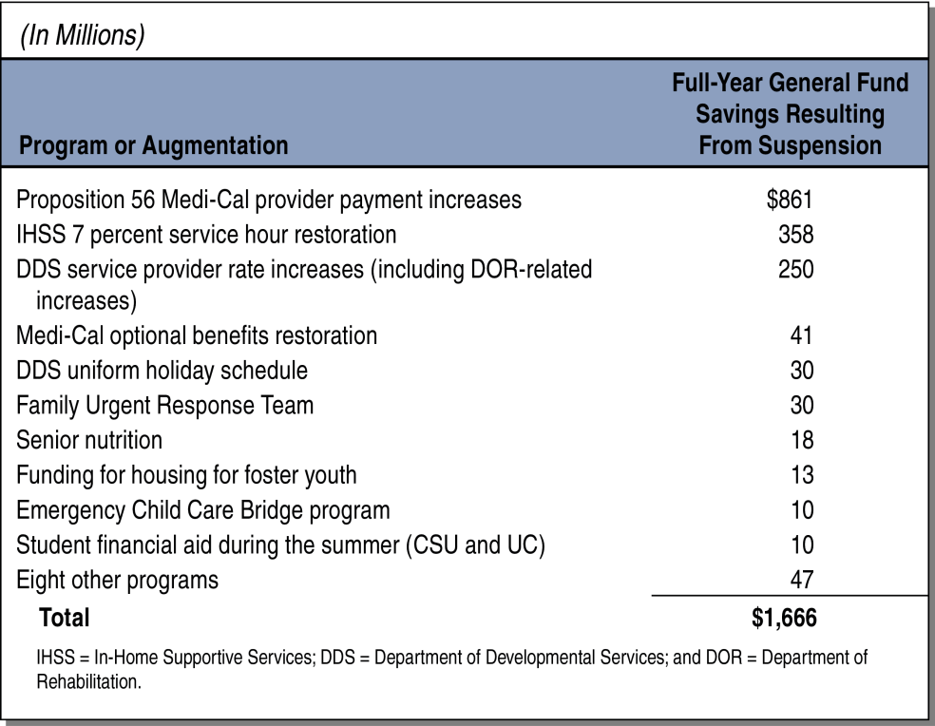
$1.7 Billion in Program Spending Subject to Suspension

